Slide 1
Sum-AppAudio-Group 4
Marco Carfora
Daniele Calisi
Francesco Bovi

Slide 2
Business concept
During the last years the awareness on the dyslexia is increased. Indeed, it has been registered a raise of students with certified dyslexia (177.000 cases in Italy), from 0.7% in 2010 to 3.2% in 2018 but the number is probably higher.
Students affected by dyslexia have difficulties in reading a text and troubles copying from the blackboard. They don’t have a way to easily grasp the concepts and to make the comprehension faster, indeed they usually need external help, like a tutor.
Sum-AppAudio is a mobile platform based on a student-to-student model to support the study of students with dyslexia. The core of the App are the recorded files that the every student can upload to summarise subject topics or book chapters. The system is designed ad hoc to overcome the difficulties that students with dyslexia have to face but also other students can enjoy the service.

Slide 3
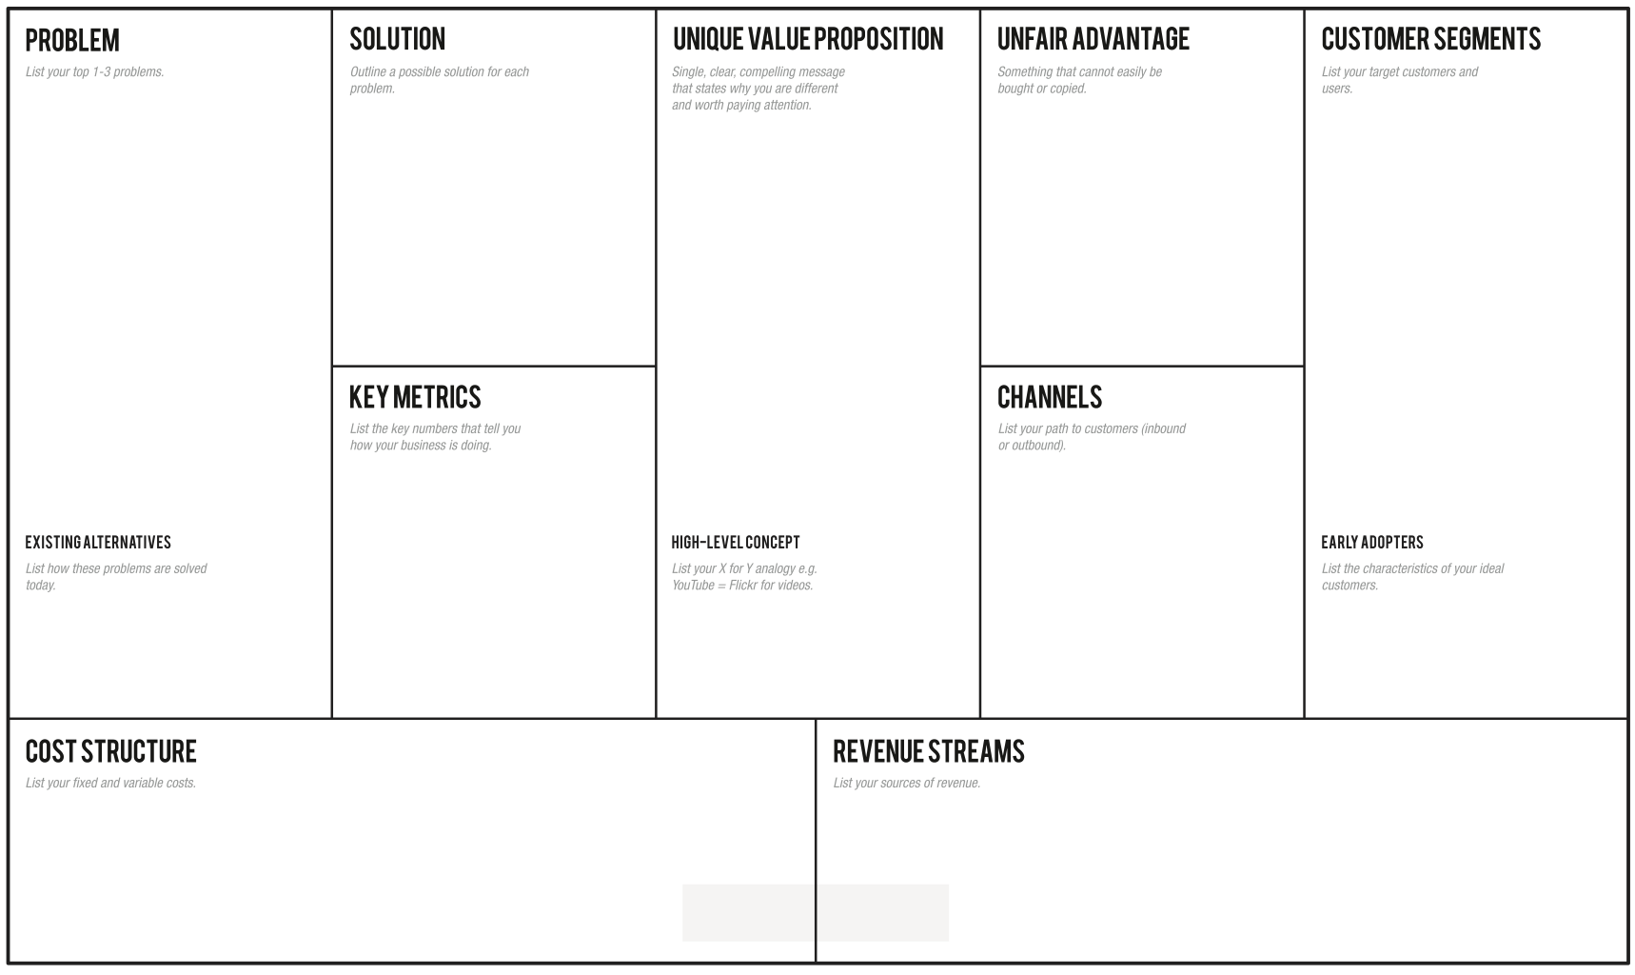
Students with dyslexia have difficulties in reading and comprehending a text:
-They don’t have a way to easily grasp the concepts, making the learning slow.
-They need an easy way to autonomously review school subjects, indeed they usually ask for external help
Through the app the students can learn in an easier and efficient way, avoiding tiring readings, relying on recordings from a huge collection built thanks to a lot of students' support
Overcome your reading and learning difficulties, enjoy a student-to-student model whose core are the recorded files that every student can upload to summarise subject topics or book chapters for students with dyslexia.
-Students with dyslexia problems (2% from primary schools, 5.6% from middle schools, 4.7% from high schools).
-Schools and pedagogical associations -Support teachers.
-Every student who want to earn some money while helping others.
-Number of uploaded recordings (monthly).
-Content quality trends thanks to feedback system.
-How many results appear for a single topic.
-Flyers distribution in front of selected schools and associations of this sector.
-A social page dealing with dyslexia problem.
-Meetings in school where we present our project to students.
Skuola.net, ad hoc textbooks, Youtube, voice synthesizers, tutors, concept maps
Sum-AppAudio = Spotify for school summaries.
Selected schools in Rome where students can help their classmates
-Server/database maintenance;
-Channels’ cost;
-Reward system costs (Gift Cards);
- Cost of the application in the mobile store;
- Partnerships with schools/associations;
- Partnerships with publishing companies to certify their content;
- Banner advertisements;

Slide 4
Validation Plan
To validate:
How:
The interest of non-dyslexic students to upload recorded files;
The usefulness of the model for dyslexic students; .
Our revenue streams;
Surveys/questionnaires on social networks; .
MVP: give audio files to dyslexic students verifying their comprehension quality;
Search for revenue information about mobile store and banner functioning;

Slide 5
THANK
YOU!

